Slide 1

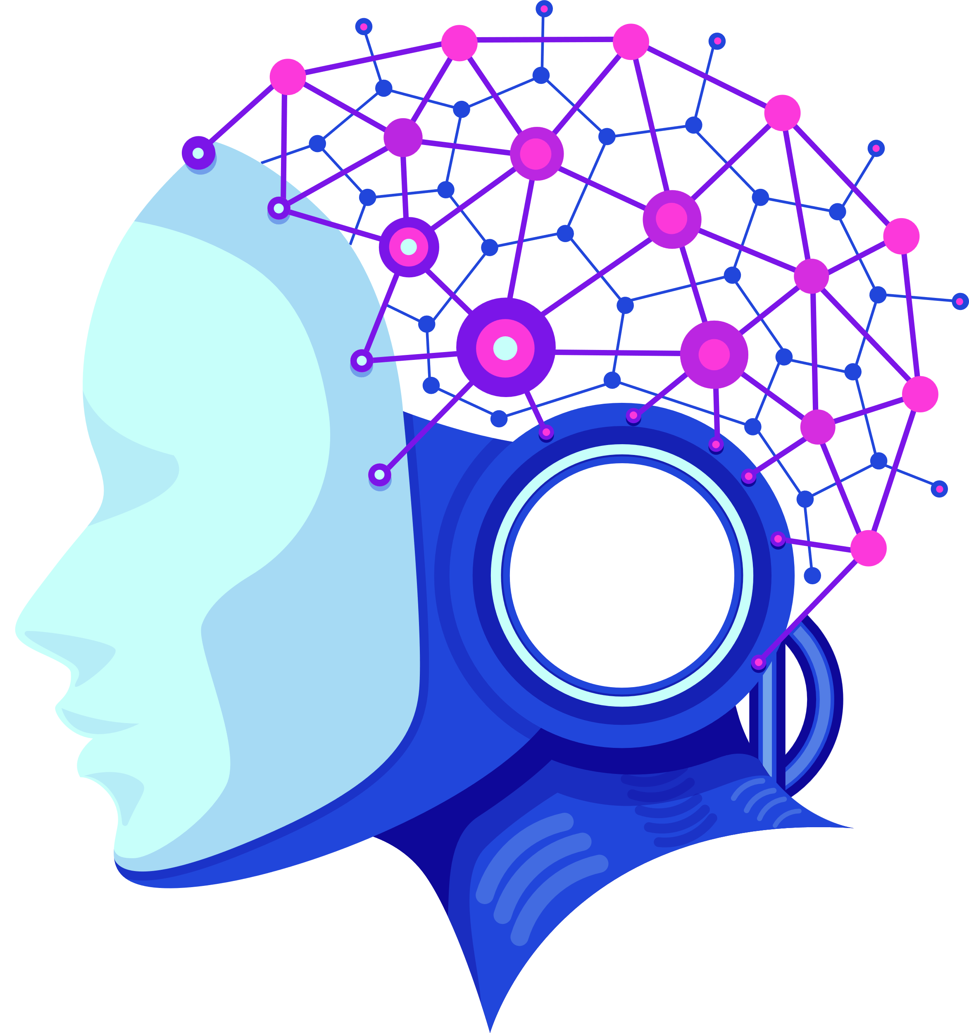
TEAM-NONAVERAGE
Project Name-MindEase
Project Theme-Mental Health Care
Member Details
Vishal Shukla
Ujjwal Rana
Vidit Jain

Slide 2
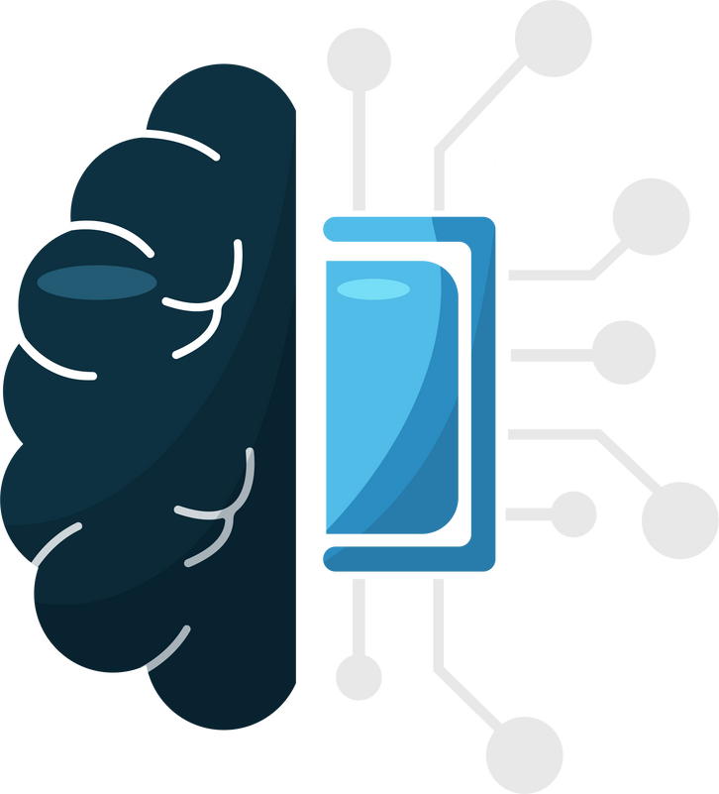

PROBLEM STATEMENT
Mental wellness apps often fall short in daily user engagement and emotional check-ins.Users either forget to log their mood, fail to engage with lengthy content, or feel that generic advice doesn’t reflect their state of mind.There’s a need for intuitive, personalized platforms that integrate seamlessly into a user’s lifestyle, providing real-time emotional tracking.
Solution
We Provide Web Platform and a Wear OS App solutions to deliver a unified experience for physical and mental health tracking, analysis, and personalized planning.
Web Platform
⌚Wearable Device Data Integration
Accepts simulated health metrics:
Heart rate, oxygen level, steps, sleep duration, activity level.
Sends to a backend API for health prediction.
🥗Personalized Diet Plan Generator
Gathers user preferences: fitness goal, dietary restrictions, and gender.
Uses a third-party AI API to generate a personalized diet in Markdown format.
Displays results with smooth scroll and readable formatting.

Slide 3
📅 Daily Mood Check-in Tracker
Emoji-based daily mood logging with optional note.
Calendar view to select and review past moods.
Helps users reflect on their emotional trends over time.
🧑‍🤝‍🧑Anonymous Chat Support System
Allows users to connect anonymously with others for emotional support.
No sign-in required — helps reduce stigma around mental health communication.
Can be enhanced to include peer matching, moderated rooms, or chatbot responders.
✨User Interface & Experience
Dark Theme & Responsive Design – Clean black-themed layout using Tailwind CSS with mobile-friendly, accessible components.
Smooth Animations – Hover effects, scaling, button spinners, and auto-scroll to results for a polished user experience.
Interactive Components – Spotlight cards, mood selection emojis, and form inputs with real-time feedback and transitions.
🏋️‍♂️Custom Workout Plan Generator
Users provide their goal, intensity, and time preferences.
Generates a structured workout plan aligned with age, activity level, and goals
Github WebApp: https://github.com/vishalshukla7551/MindEase
Deployed link :https://mind-ease-fawn.vercel.app/

Slide 4
Wear OS App
🩺Real-Time Health Monitoring via Wear OS & ML Prediction
Our Wear OS app collects sensor data including heart rate, blood oxygen, sleep, and step count.
This real-time health data is analyzed using a machine learning model via an API.
The model predicts the user’s current mental and physical fitness status.
This helps in early detection of stress, fatigue, or mental imbalance.
🧠Deeper Mental Readiness Insights from Physical Fitness Metrics
The app also collects metrics like BMI, body fat %, sit-ups, and flexibility using fitness sensors.
These are sent to a second API trained to assess mental readiness and alertness levels.
The response includes prediction value and confidence score.
This gives users insights into how their physical health reflects their mental wellbeing.
Github Repo Wear OS App:https://github.com/viditjain44/MindEase

Slide 5
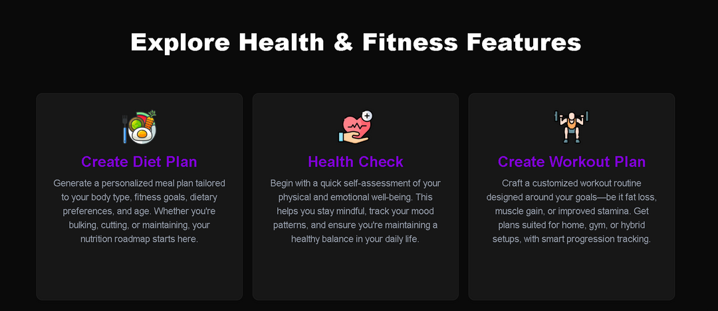
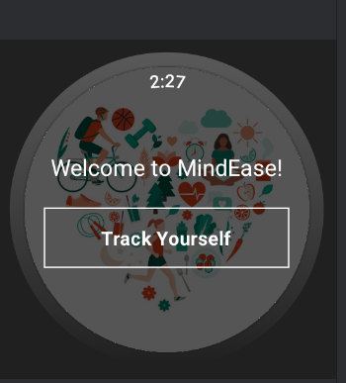
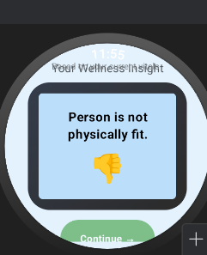
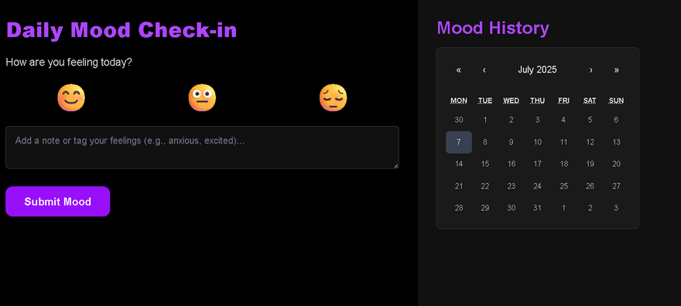
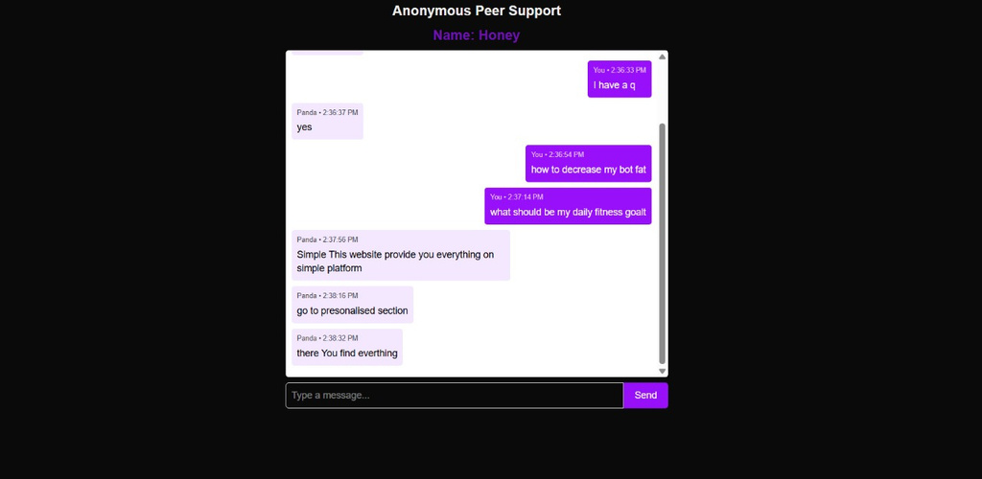
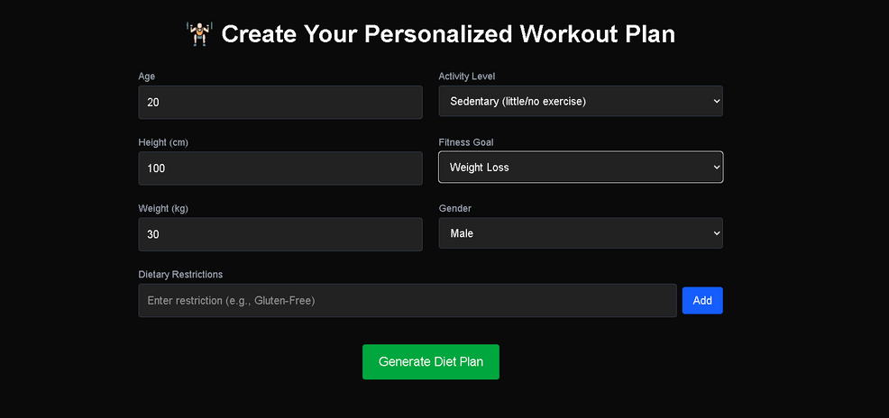
Models Render link :
1.https://chatbot-fitness.onrender.com
2.https://stopwatch-measure.onrender.com
3.https://fitness-measure-6df8.onrender.com

Slide 6
Advantages
Technology Stack/Dependencies
Accessibility: Across Devices Users can access their mental health data and resources from desktops, tablets, phones or smartwatch needed.
Framework: Next.js, React, Tailwind CSS,Kotlin
Backend: Node.js, Express.js,Python
AI Models: Generative model Google Gemini
Authentication: Clerk/Auth0
Integration:Mental Health check Models, Diet plan Models ,Workout Models
Ui Library:frame motion,Gsap
Deployment: Vercel
Platforms : VS Code , Android Studio
Detailed Analytics Dashboard:The website can display long-term trends in heart rate, sleep, BMI, etc., with visuals for better mental health tracking.
Anonymous Chat Support System:Offers a safe space for users to talk with therapists or peers without revealing their identity.
Integration with Wear OS Data:Real-time sensor data from the smartwatch syncs to the website for centralized record-keeping and insights.
Workout Plans for Mental & Physical Health:Generates simple, guided exercises tailored to user stats like heart rate and sit-up count to boost both fitness and mood.

Slide 7
Thankyou !!!

